Slide 1

The National University of Computer and Emerging Sciences
Logistic Regression
Machine Learning for Data Science
Dr. Akhtar Jamil
Department of Computer Science

Slide 2
Goals
Review of Previous Lecture
Today’s Lecture
Logistic Regression

Slide 3
Review Of Previous Lecture

Slide 4
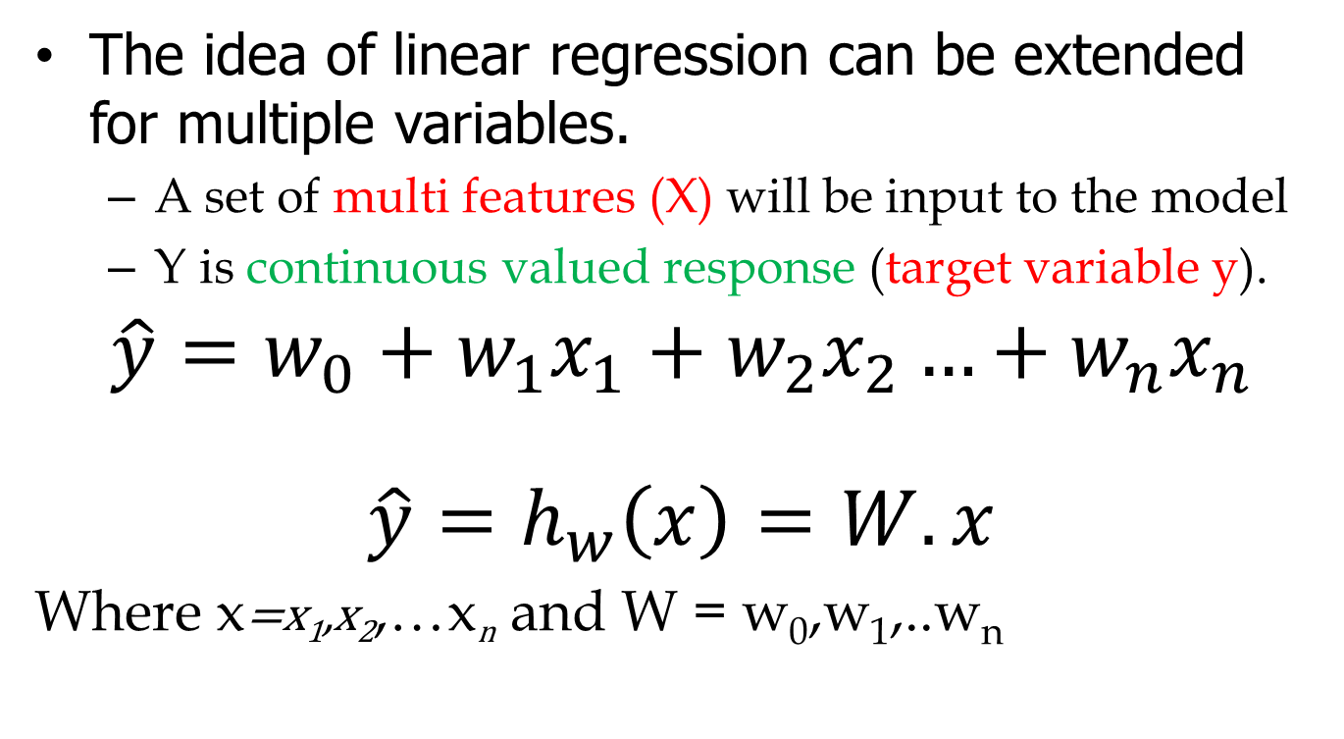
Linear regression with multiple features
The idea of linear regression can be extended for multiple variables.
A set of multi features (X) will be input to the model
Y is continuous valued response (target variable y).
$$\hat{y}=w_{0}+w_{1}x_{1}+w_{2}x_{2}…+w_{n}x_{n}$$
$$\hat{y}=h_{w}\left(x\right)=W.x$$
Where x=x₁,x₂,…x_{n} and W = w₀,w₁,..w_{n}

Slide 5
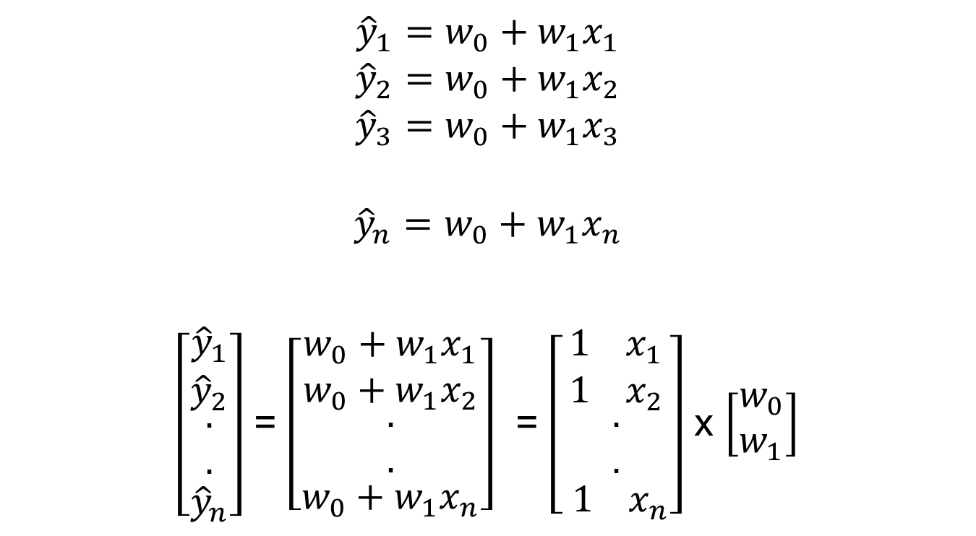
Linear regression with multiple features
$${\hat{y}}_{1}=w_{0}+w_{1}x_{1}$$
$${\hat{y}}_{2}=w_{0}+w_{1}x_{2}$$
$${\hat{y}}_{3}=w_{0}+w_{1}x_{3}$$
$${\hat{y}}_{n}=w_{0}+w_{1}x_{n}$$
$\left[\begin{aligned}\begin{matrix}{\hat{y}}_{1} \\ {\hat{y}}_{2} \\ \begin{aligned}. \\ .\end{aligned}\end{matrix} \\ {\hat{y}}_{n}\end{aligned}\right]$ = $\left[\begin{aligned}\begin{matrix}w_{0}+w_{1}x_{1} \\ w_{0}+w_{1}x_{2} \\ \begin{aligned}. \\ .\end{aligned}\end{matrix} \\ w_{0}+w_{1}x_{n}\end{aligned}\right]$ = $\left[\begin{aligned}\begin{matrix}1 x_{1} \\ 1 x_{2} \\ \begin{aligned}. \\ .\end{aligned}\end{matrix} \\ 1 x_{n}\end{aligned}\right]$ x $\left[\begin{aligned}w_{0} \\ w_{1}\end{aligned}\right]$

Slide 6
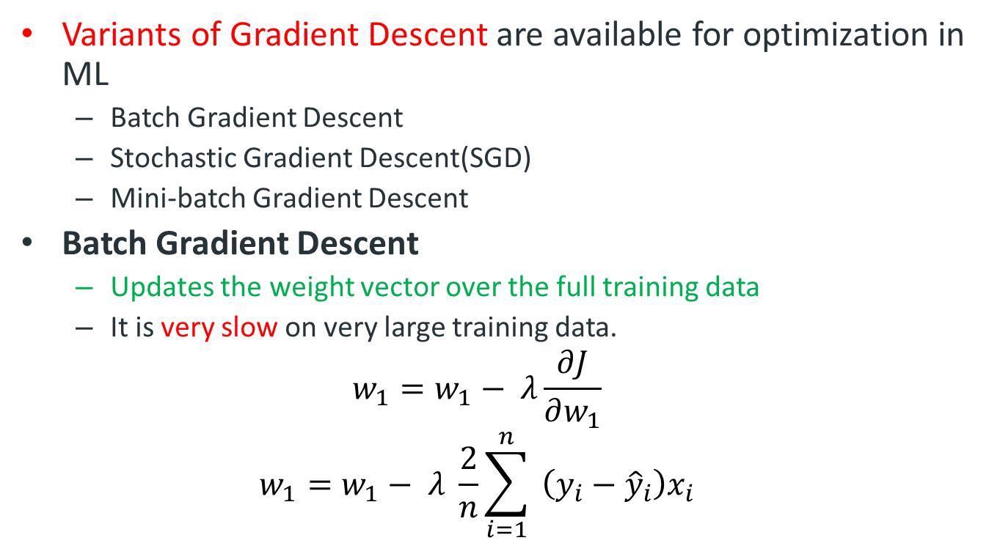
Optimization: Gradient Descent
Variants of Gradient Descent are available for optimization in ML
Batch Gradient Descent
Stochastic Gradient Descent(SGD)
Mini-batch Gradient Descent
Batch Gradient Descent
Updates the weight vector over the full training data
It is very slow on very large training data.
$$w_{1}=w_{1}− λ\frac{∂J}{∂w_{1}}$$
$$w_{1}=w_{1}− λ \frac{2}{n}\sum_{i=1}^{n}{ }\left(y_{i}−{\hat{y}}_{i}\right)x_{i}$$

Slide 7
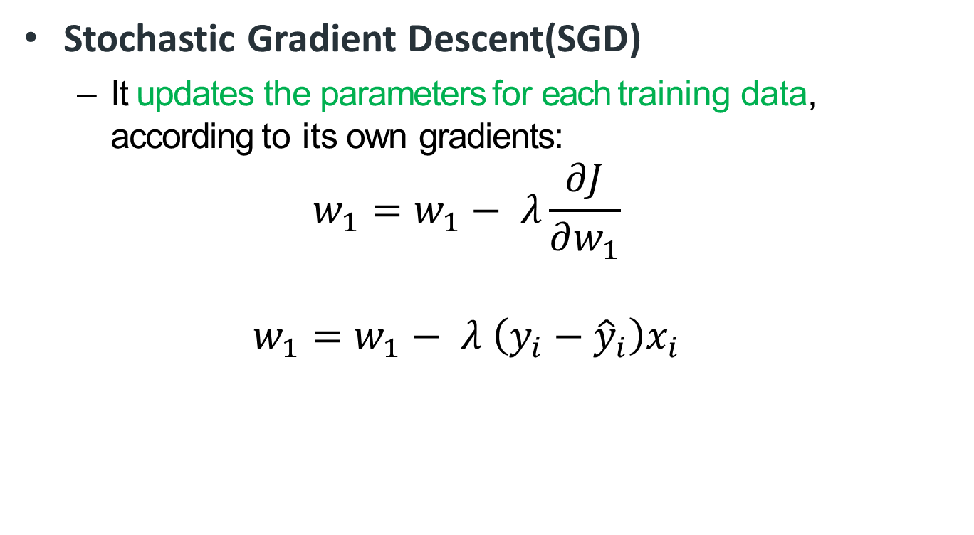
Optimization: Gradient Descent
Stochastic Gradient Descent(SGD)
It updates the parameters for each training data, according to its own gradients:
$$w_{1}=w_{1}− λ\frac{∂J}{∂w_{1}}$$
$$w_{1}=w_{1}− λ \left(y_{i}−{\hat{y}}_{i}\right)x_{i}$$

Slide 8
Optimization: Gradient Descent
Mini-batch Gradient Descent
It computes the gradients on small random sets of instances called mini-batches.
It has shown better performance than SGD
More robust stable than SGD

Slide 9
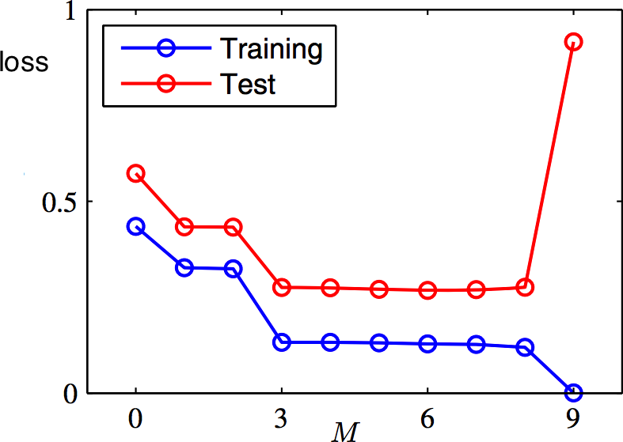
Generalization

Slide 10
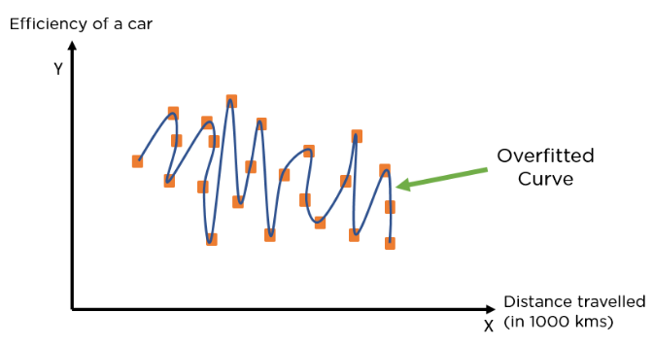
Overfitting

Slide 11
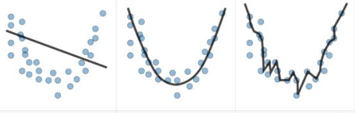
Underfitting vs Overfitting

Slide 12
Feature Scaling
Feature scaling in machine learning is an important pre-processing steps
Affect performance of the model
The difference in range of values of features may cause one feature to dominate other.
The most commonly used techniques:
Normalization
Standardization.

Slide 13
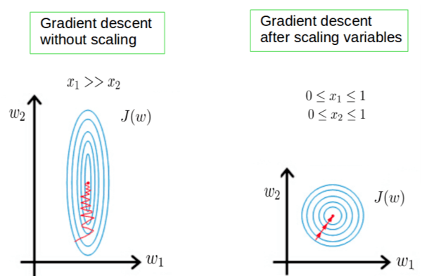
Feature Scaling

Slide 14
Today’s Lecture

Slide 15


Odds in Probability
Example:
A survey of 250 customers was conducted for an automobile dealership. The customers were asked if they would recommend the service department to a friend. The number who responded Yes was 210.
The proportion (probability) of customers who recommend is
So, the proportion of customers who would not recommend the service department are:

Slide 16

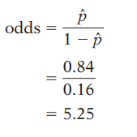
Odds in Probability
The odds are simply the ratio of the proportions for the two possible outcomes.
If p is the proportion for one outcome, then 1 - p is the proportion for the second outcome:

Slide 17
Odds in Probability
Odd usually use integers or fractions.
5.25 to 5.
The odds are approximately 5 to 1 that a customer would recommend the service to a friend.
In a similar way, we could describe the odds that a customer would not recommend the service as 1 to 5.

Slide 18
Logistic Regression
Linear regression models the relationship between a response variable and one or more explanatory variables.
For categorical response variable with two possible values, Similar Regression Models can also be used
Spam or Not Spam
Patient Dies or Survives
Tumor Benign or Malignant.

Slide 19
Logistic Regression
Classification, like regression, is a predictive task
But one in which the outcome takes only values across discrete categories;
Classification problems are very common (more common than regression problems!)
The objective function should be modified
Fundamentals will be same as regression

Slide 20
Logistic Regression
Logistic Regression (also called Logit Regression) is commonly used to estimate the probability for each class
What is the probability that this email is spam?
Can a binary classifier be constructed using probability?
If the estimated probability > 50%, the instance belongs positive class
Otherwise, it belongs to the negative class

Slide 21
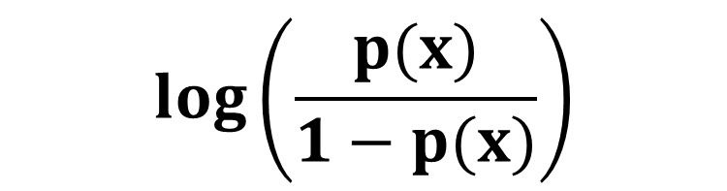
Logistic Regression
It is a supervised method for classification
“Logit” = “Log Odds”
p(y=0|x) or p(y=1|x)?
$$log⁡\left(\frac{p(x)}{1−p(x)}\right)$$

Slide 22
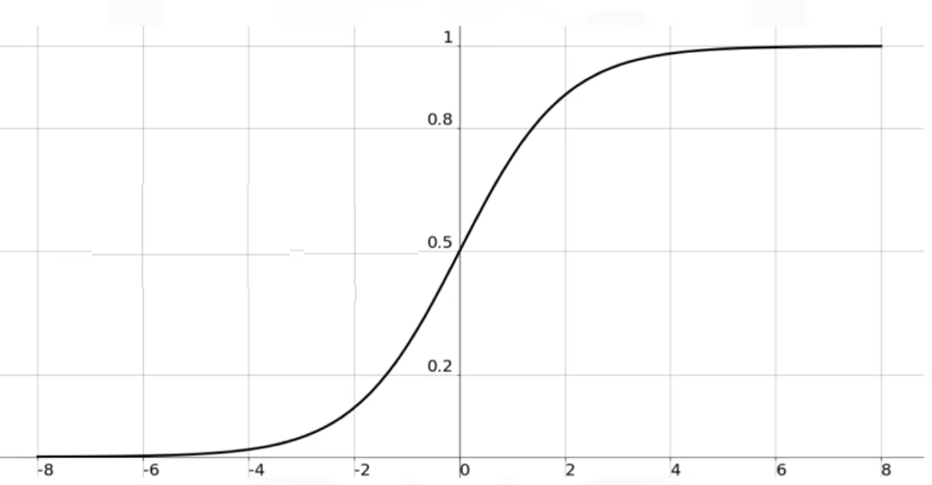

Logistic Regression
Suppose p(y=1|x) = p(x)
Sigmoid Function:
p$(x)= \frac{1}{1+e^{−W^{T}X}}$

Slide 23
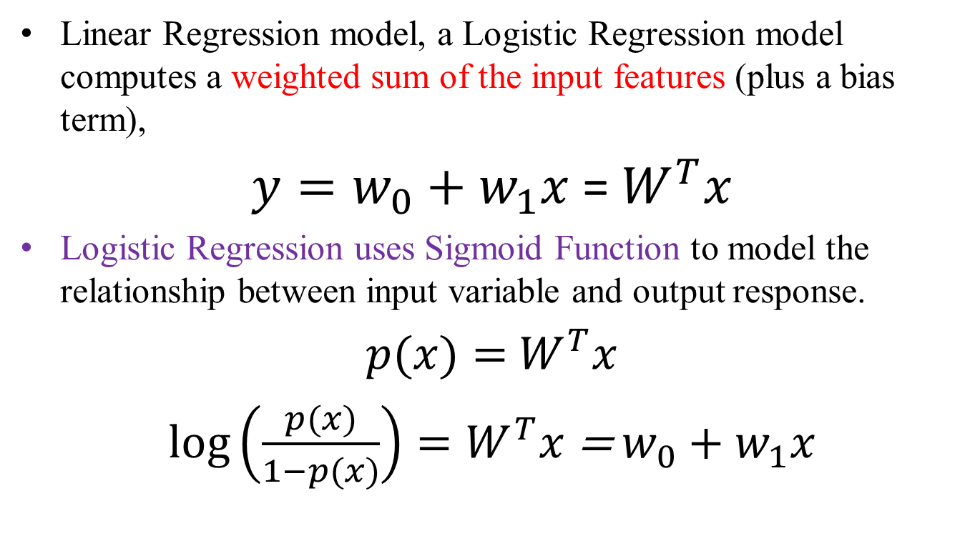
Logistic Regression
Linear Regression model, a Logistic Regression model computes a weighted sum of the input features (plus a bias term),
$y=w_{0}+w_{1}x$ = $W^{T}x$
Logistic Regression uses Sigmoid Function to model the relationship between input variable and output response.
$p(x)=$ $W^{T}x$
$log⁡\left(\frac{p(x)}{1−p(x)}\right)=W^{T}x$ = $w_{0}+w_{1}x$

Slide 24
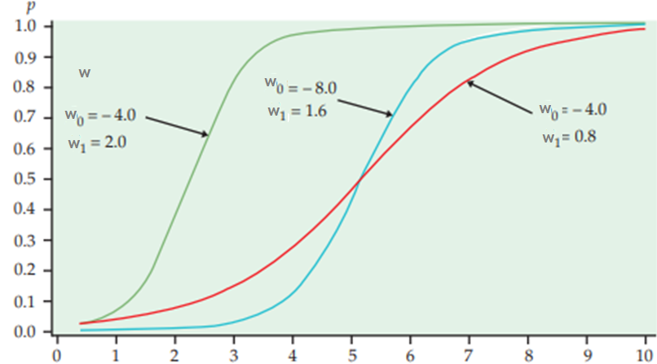
Logistic Regression

Slide 25
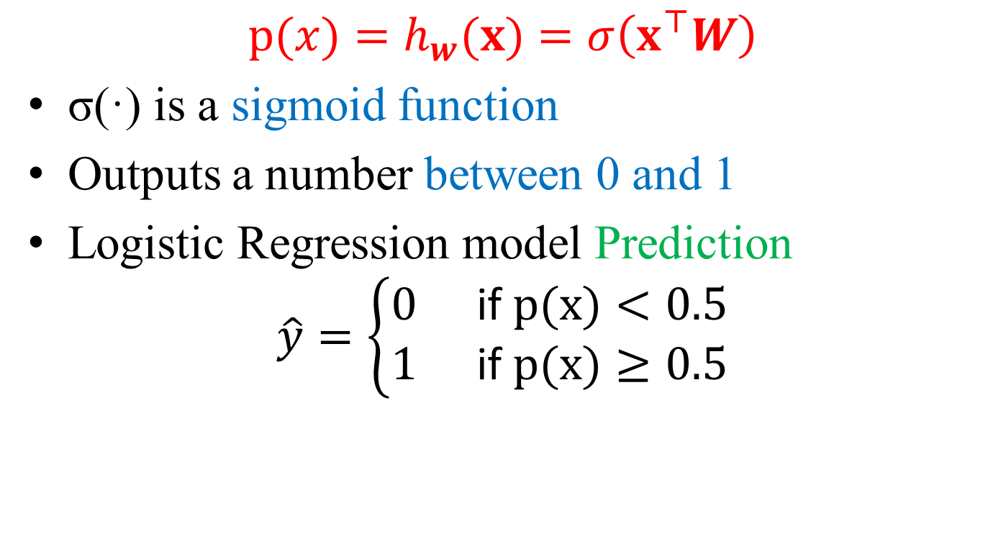
Logistic Regression
$$p(x)=h_{w}(x)=σ\left(x^{⊤}W\right)$$
σ(·) is a sigmoid function
Outputs a number between 0 and 1
Logistic Regression model Prediction
$$\hat{y}=\left\{\begin{aligned}&0 && \text{if} p(x)<0.5 \\ &1 && \text{if} p(x)≥0.5\end{aligned}\right.$$

Slide 26
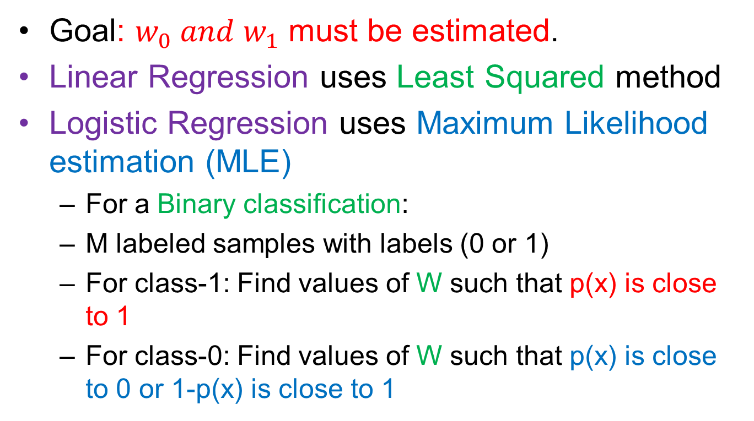
Logistic Regression
Goal: $w_{0} and w_{1}$ must be estimated.
Linear Regression uses Least Squared method
Logistic Regression uses Maximum Likelihood estimation (MLE)
For a Binary classification:
M labeled samples with labels (0 or 1)
For class-1: Find values of W such that p(x) is close to 1
For class-0: Find values of W such that p(x) is close to 0 or 1-p(x) is close to 1

Slide 27
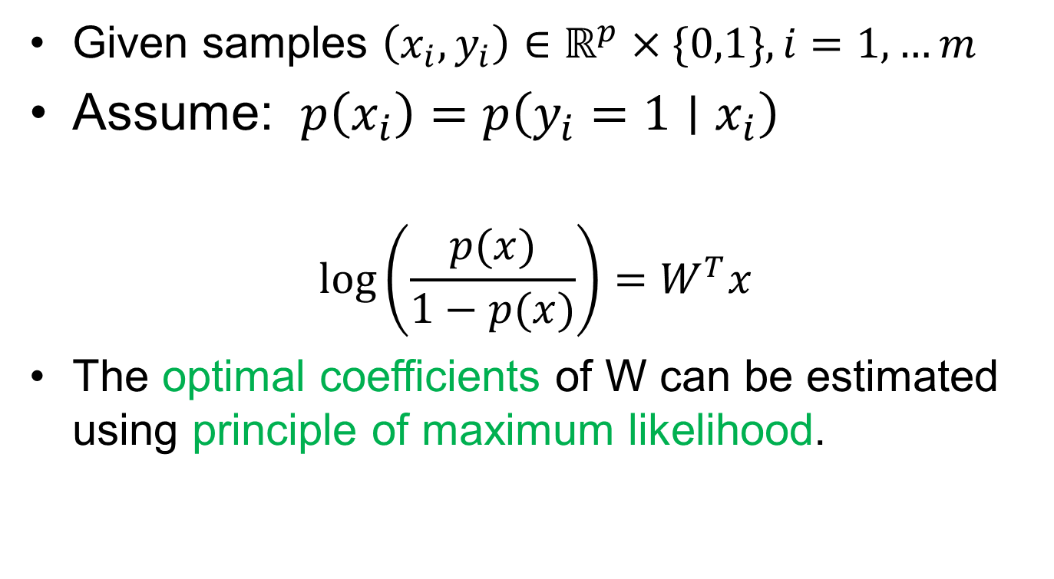
Logistic Regression
Given samples $\left(x_{i},y_{i}\right)∈ℝ^{p}×\{0,1\},i=1,…m$
Assume: $p\left(x_{i}\right)=p\left(y_{i}=1∣x_{i}\right)$
$$log⁡\left(\frac{p(x)}{1−p(x)}\right)=W^{T}x$$
The optimal coefficients of W can be estimated using principle of maximum likelihood.

Slide 28
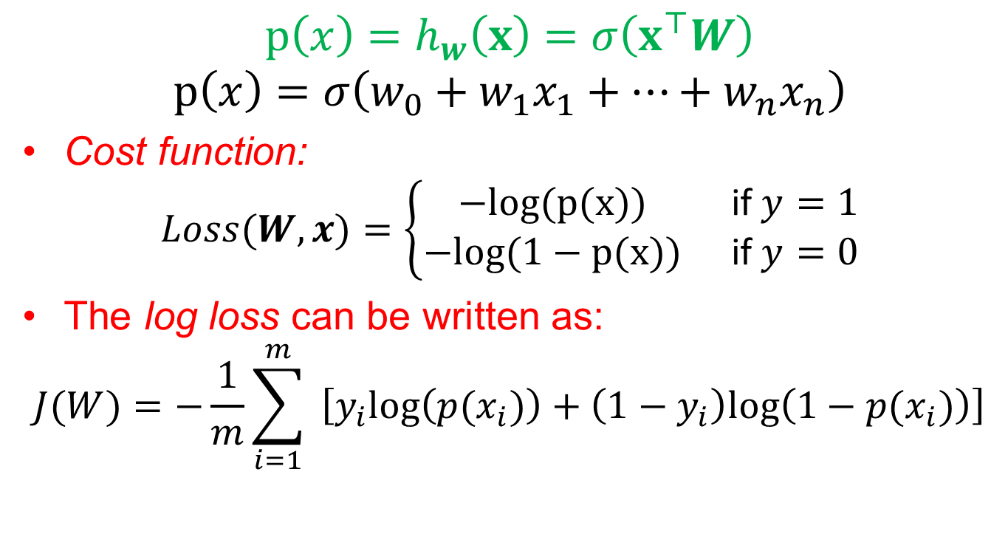
Logistic Regression
$$p\left(x\right)=h_{w}\left(x\right)=σ\left(x^{⊤}W\right)$$
$$p\left(x\right)=σ\left(w_{0}+w_{1}x_{1}+…+w_{n}x_{n}\right)$$
Cost function:
$$Loss(W,x)=\left\{\begin{matrix}−log⁡(p(x)) & \text{if} y=1 \\ −log⁡(1−p(x)) & \text{if} y=0\end{matrix}\right.$$
The log loss can be written as:
$$J(W)=−\frac{1}{m}\sum_{i=1}^{m}{ }\left[y_{i}log⁡\left(p(x_{i})\right)+\left(1−y_{i}\right)log⁡\left(1−p(x_{i})\right)\right]$$

Slide 29
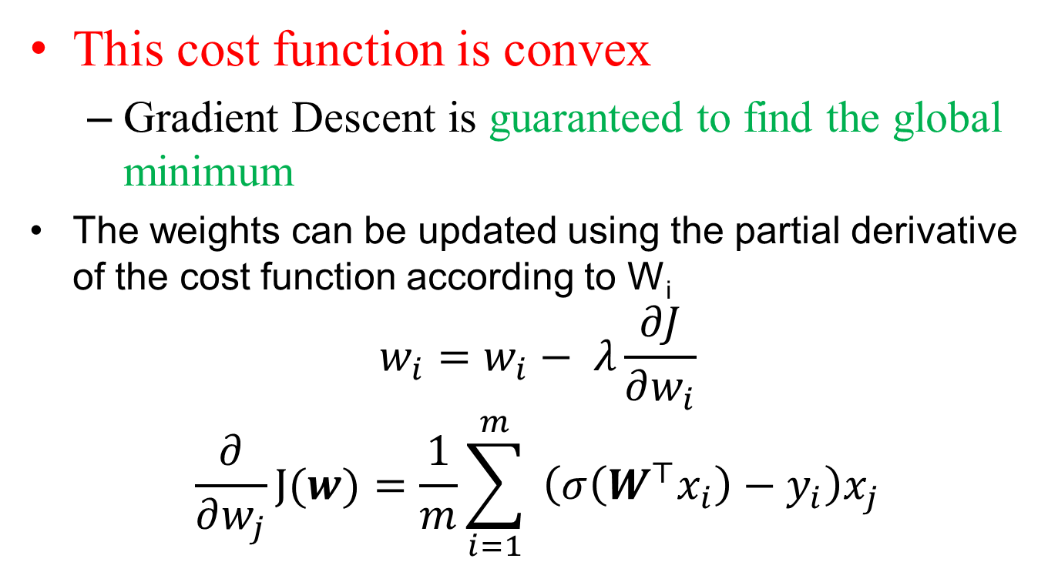
Logistic Regression
This cost function is convex
Gradient Descent is guaranteed to find the global minimum
The weights can be updated using the partial derivative of the cost function according to W_{i}
$$w_{i}=w_{i}− λ\frac{∂J}{∂w_{i}}$$
$$\frac{∂}{∂w_{j}}J(w)=\frac{1}{m}\sum_{i=1}^{m}{ }\left(σ\left(W^{⊤}x_{i}\right)−y_{i}\right)x_{j}$$

Slide 30
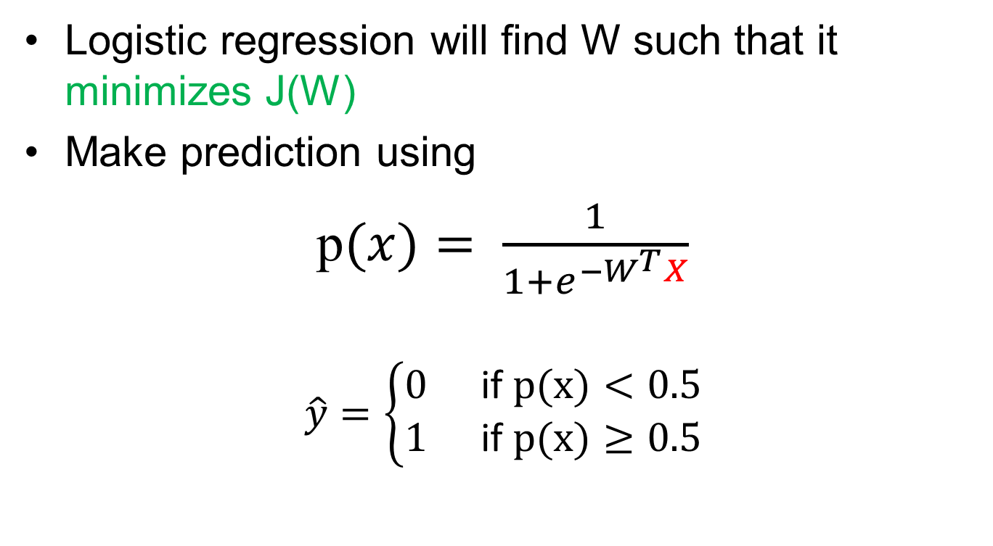
Logistic Regression
Logistic regression will find W such that it minimizes J(W)
Make prediction using
p$(x)= \frac{1}{1+e^{−W^{T}X}}$
$$\hat{y}=\left\{\begin{aligned}&0 && \text{if} p(x)<0.5 \\ &1 && \text{if} p(x)≥0.5\end{aligned}\right.$$

Slide 31
Multinomial regression
Can we extend the Logistic Regression model for multiclass classification(more than two) problems?
Yes ☺
Multinomial model regression
We can use One-vs-Rest (One-vs-all)
Divide the problem into many sub problems (binary)
Train separate model for one class vs rest classes
Repeat for all possible combinations for every class

Slide 32
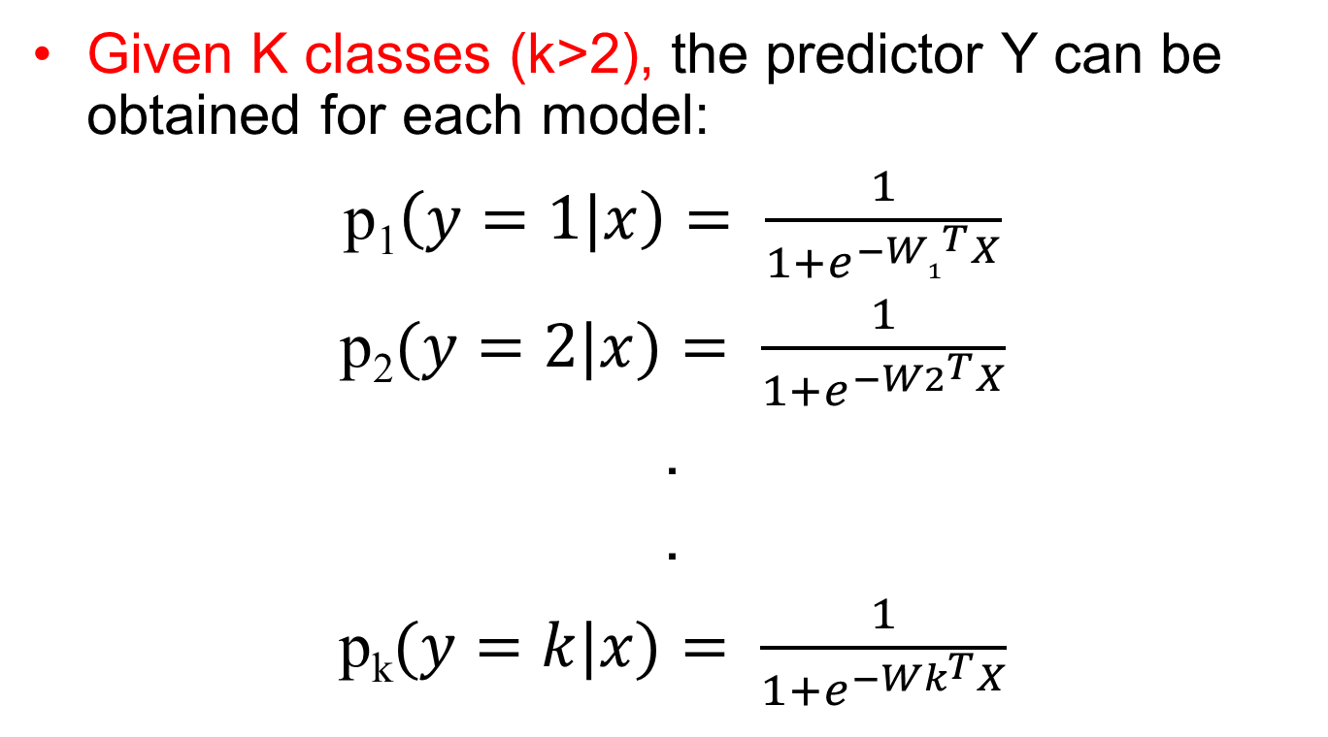
Multinomial regression
Given K classes (k>2), the predictor Y can be obtained for each model:
p₁$\left(y=1|x\right)= \frac{1}{1+e^{−{W1}^{T}X}}$
p₂$(y=2|x)= \frac{1}{1+e^{−{W2}^{T}X}}$
.
.
p_{k}$(y=k|x)= \frac{1}{1+e^{−{Wk}^{T}X}}$

Slide 33

Multinomial regression
For a new input data X will be passed through each model and get probabilities.
The instance will be assigned to the class with maximum probability

Slide 34
Reference
Chapter 5, Deep Learning MIT Press 2016, Ian Goodfellow
Chapter 3 Pattern Recognition and Machine Learning, Christopher M. Bishop
Some graphics from the internet:
https://towardsdatascience.com/all-about-feature-scaling-bcc0ad75cb35

Slide 35
Thank You ☺

